Slide 1
Cindy Sherman
Noor Chisti
Art 130!
Professor SherrI Archer

Slide 2
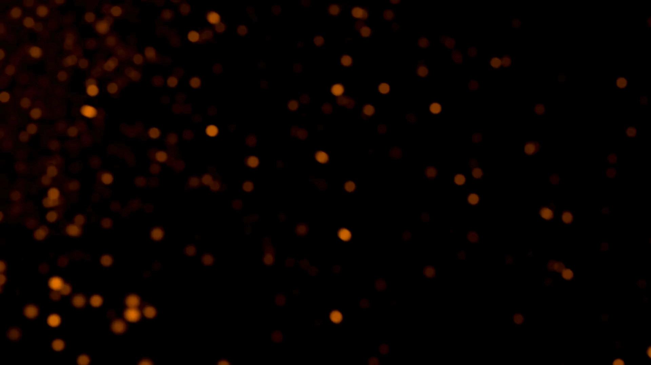
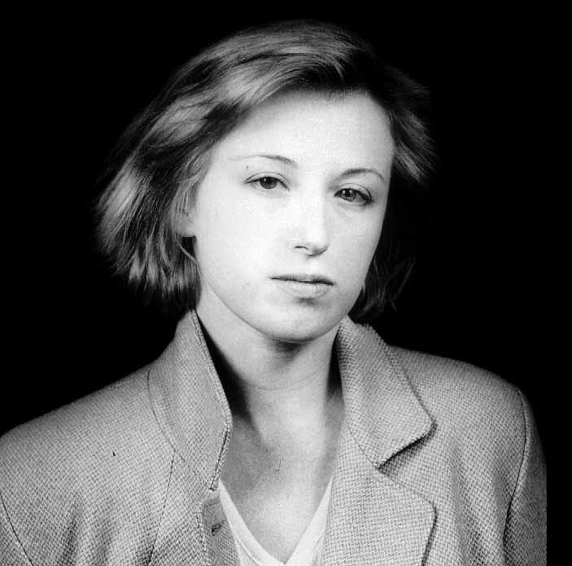
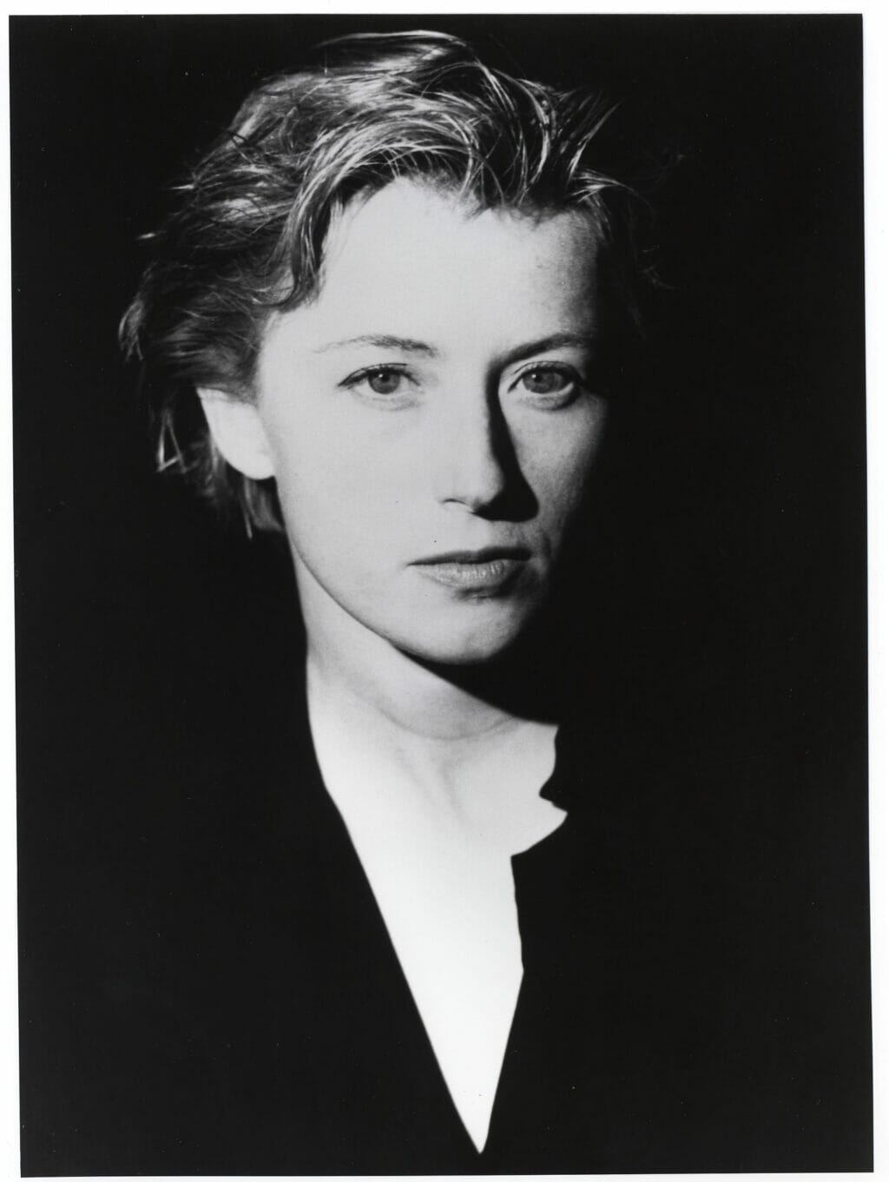
Introduction
Born January 19, 1954, in Glen Ridge, New Jersey
Abandoned painting for photography while studying at the State University of New York at Buffalo
Moved to New York in 1976 to pursue a career as a photographer
Lived with artist Robert Longo from 1974 to 1980, who also included her in his 'Men in the Cities' series of photographs.
Married director Michel Auder in 1984; the marriage ended in divorce in 1999.
Engaged in a 5-year relationship with Paul Hasegawa-Overacker, creator of a documentary film about Sherman.
Dated artist David Byrne from 2007 to 2011.
Sherman has been known to lead a private life, with her personal relationships often kept out of the public eye.

Slide 3
Introduction
Early Career and Breakthrough
Sherman's early work experimented with different identities and personas, foreshadowing her later exploration of identity and representation.
Her breakthrough series, the "Untitled Film Stills" (1977–1980), catapulted her to international acclaim, showcasing her talent for embodying various roles and challenging cultural stereotypes.
Impact and Legacy
Sherman's influence extends far beyond the realm of photography, shaping contemporary discourse on gender, identity, and representation.
Her innovative approach to self-portraiture continues to inspire artists and provoke critical reflection on the complexities of human existence.

Slide 4
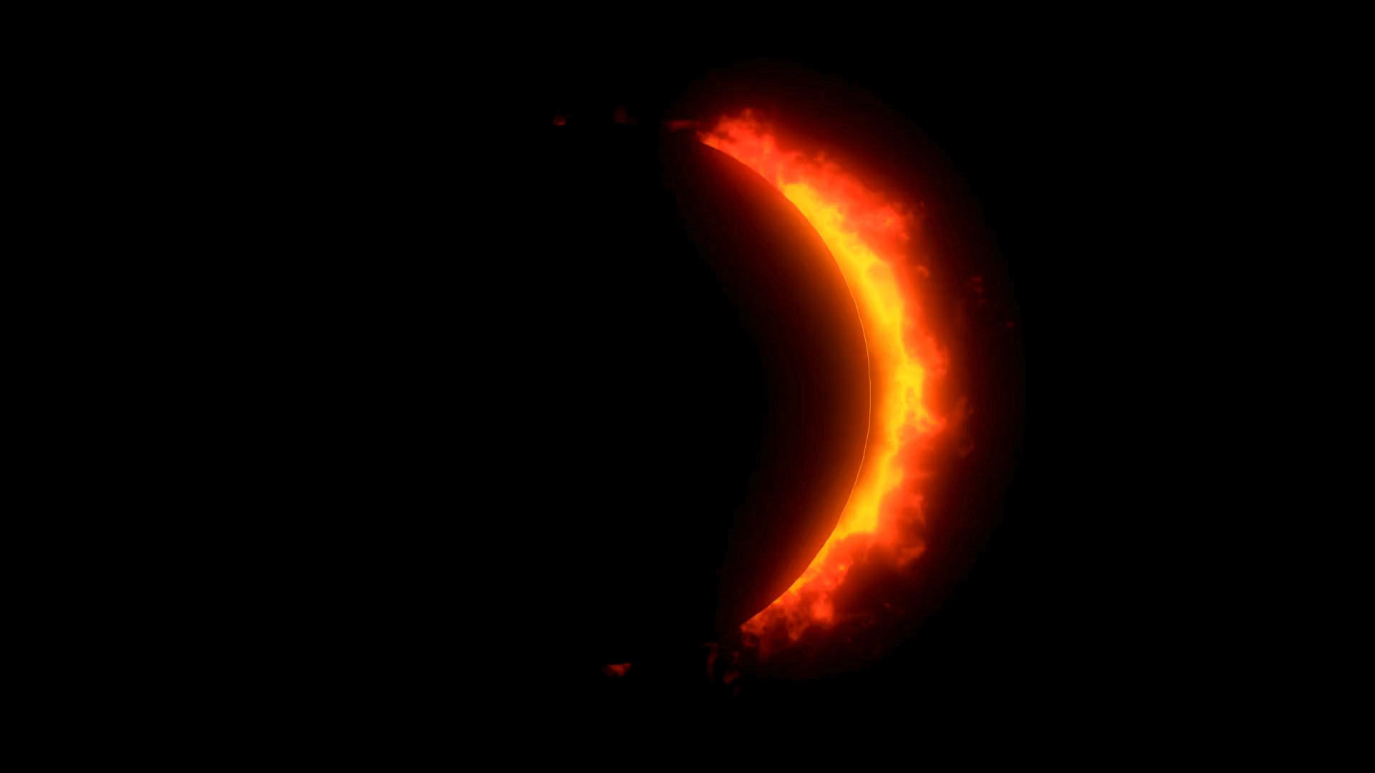
Medium
Photography as Primary Medium
Cindy Sherman's primary mode of artistic expression.
Utilized photography to explore identity and representation.
Experimentation with Black-and-White and Color
Early work in black-and-white photography : Untitled Film Stills" (1977–1980)
Transition to color photography in later series (e.g., "History Portraits").
Use of Props and Costumes
Employed props and costumes to embody various characters.
Manipulated visual elements to challenge societal norms and expectations.

Slide 5
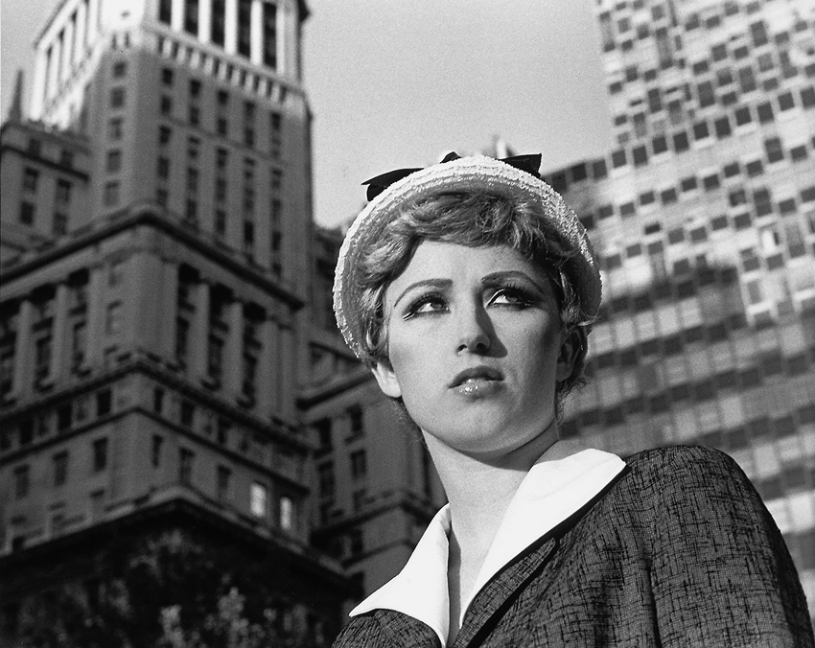
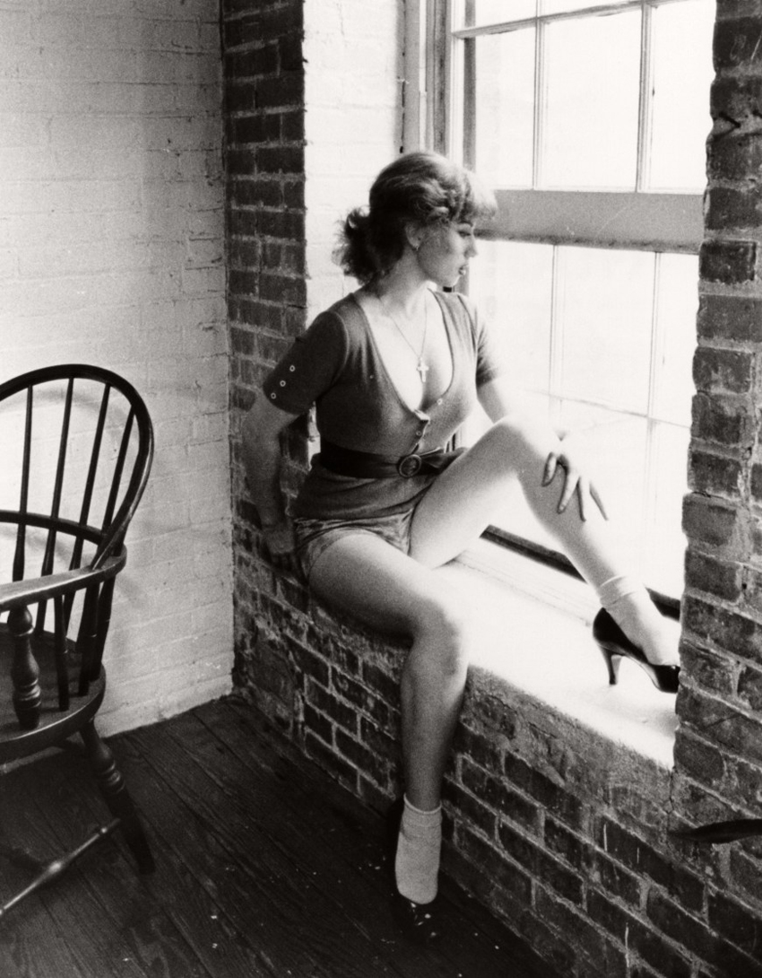
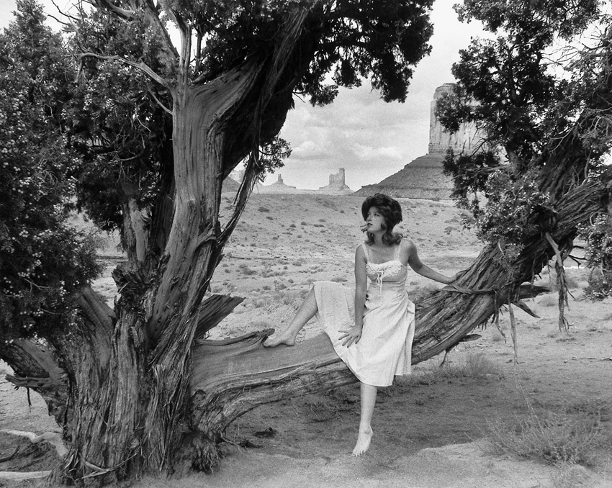
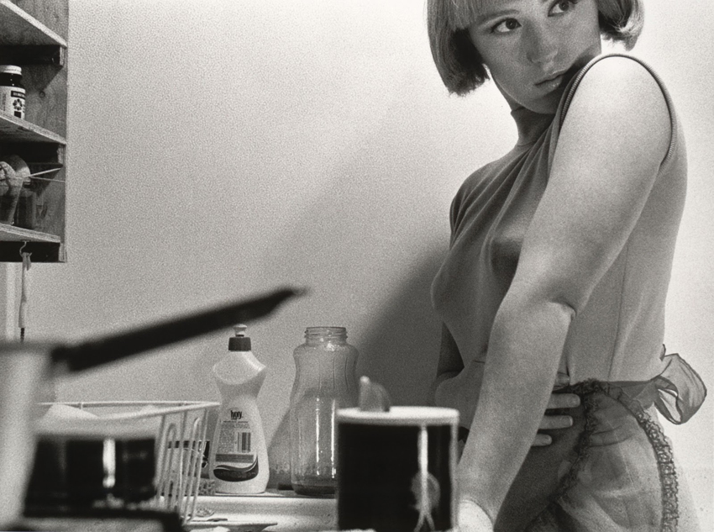
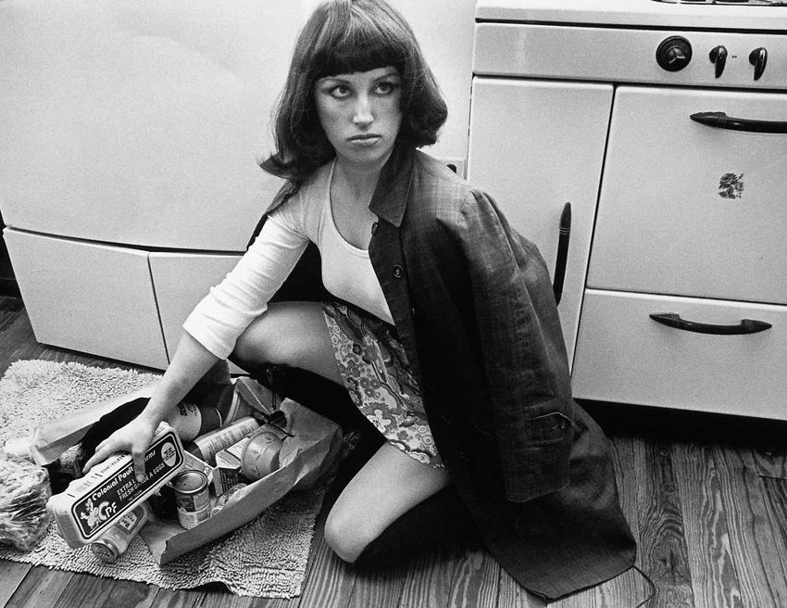
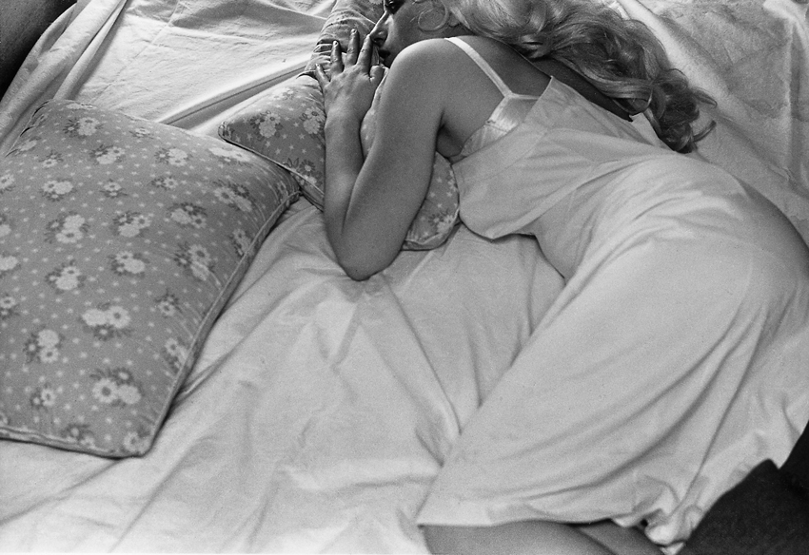
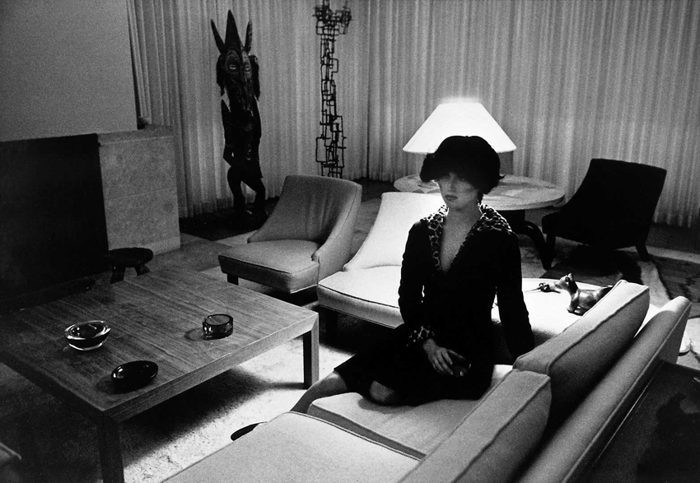
Untitled Film Stills" (1977–1980)

Slide 6
Medium
Photography as Primary Medium
Cindy Sherman's primary mode of artistic expression.
Utilized photography to explore identity and representation.
Experimentation with Black-and-White and Color
Early work in black-and-white photography : Untitled Film Stills" (1977–1980)
Transition to color photography in later series "History Portraits"
Use of Props and Costumes
Employed props and costumes to embody various characters.
Manipulated visual elements to challenge societal norms and expectations.

Slide 7
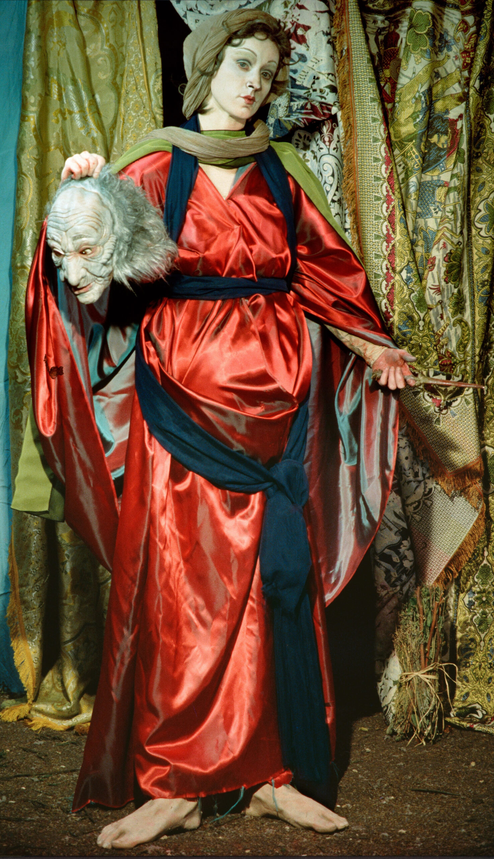
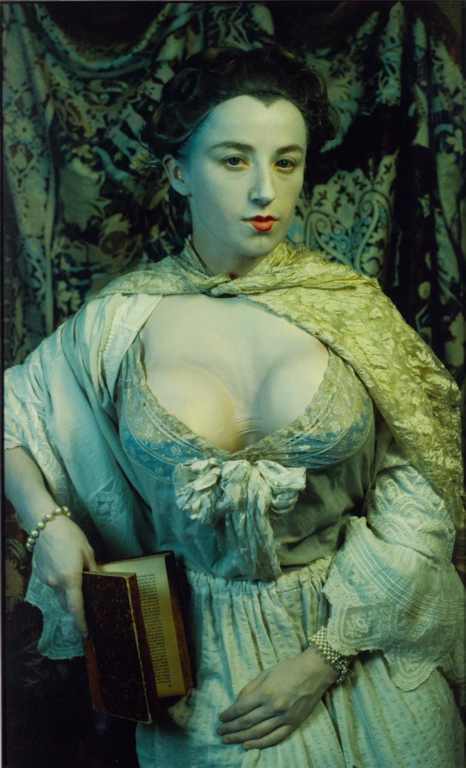
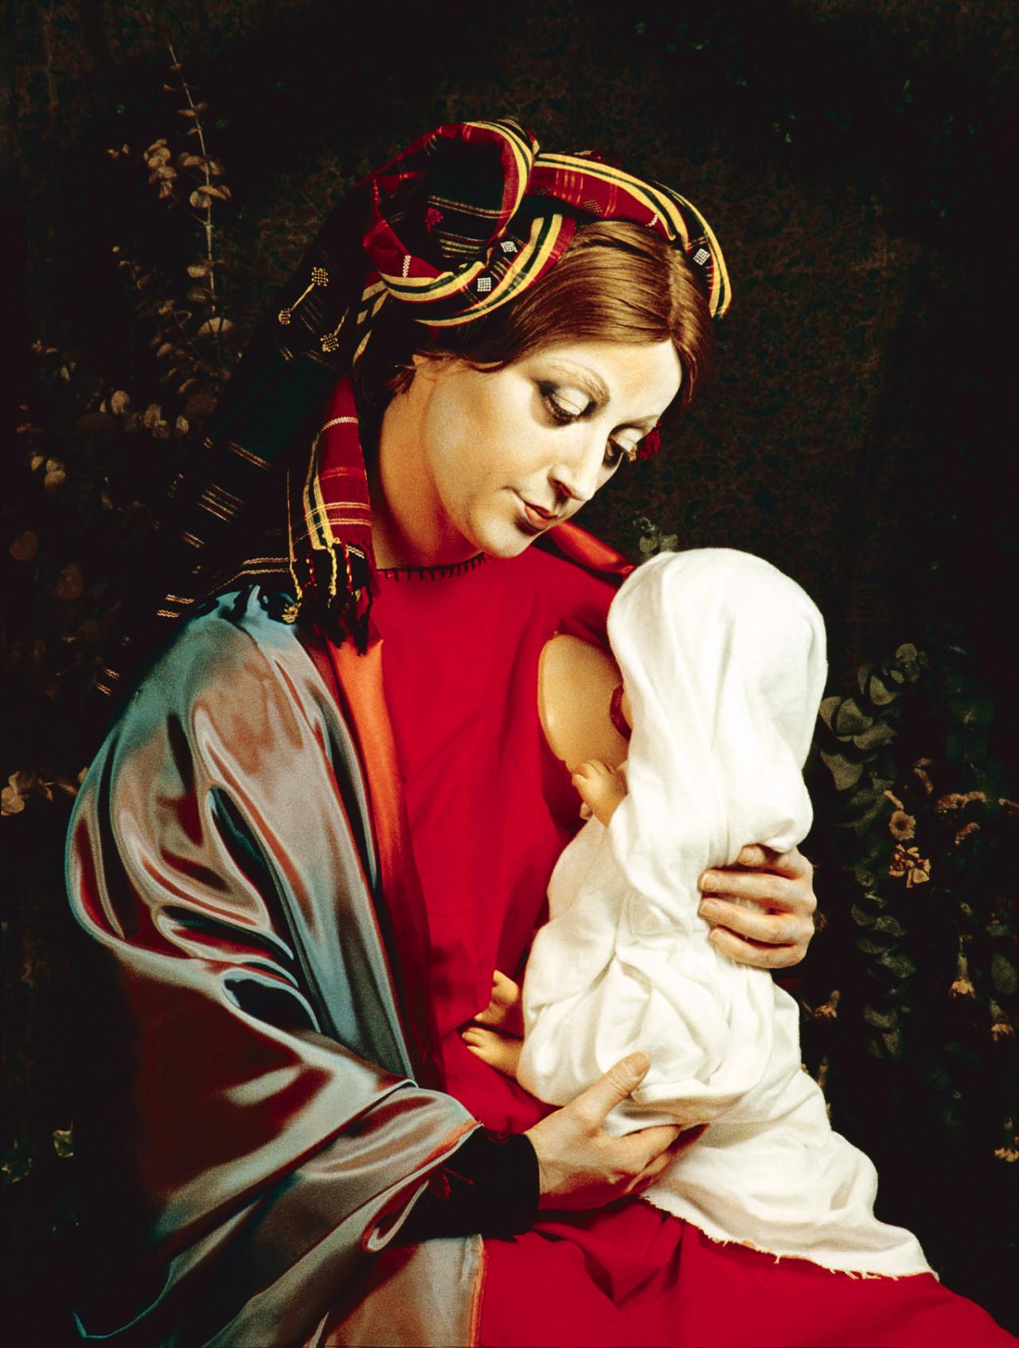
History Portraits series (1988–1990)

Slide 8
Medium
Photography as Primary Medium
Cindy Sherman's primary mode of artistic expression.
Utilized photography to explore identity and representation.
Experimentation with Black-and-White and Color
Early work in black-and-white photography : Untitled Film Stills" (1977–1980)
Transition to color photography in later series "History Portraits"
Use of Props and Costumes
Employed props and costumes to embody various characters.
Manipulated visual elements to challenge societal norms and expectations.

Slide 9
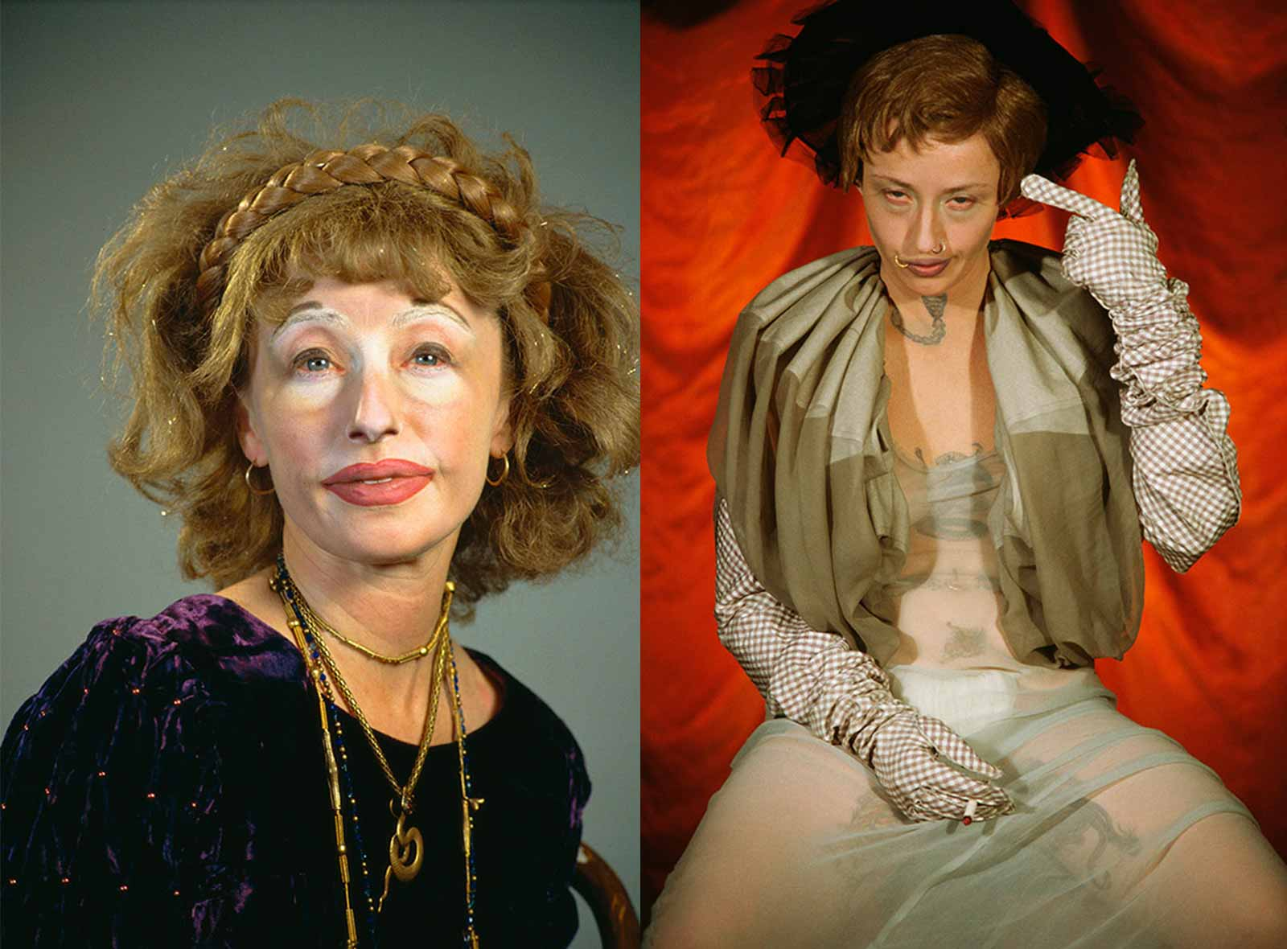
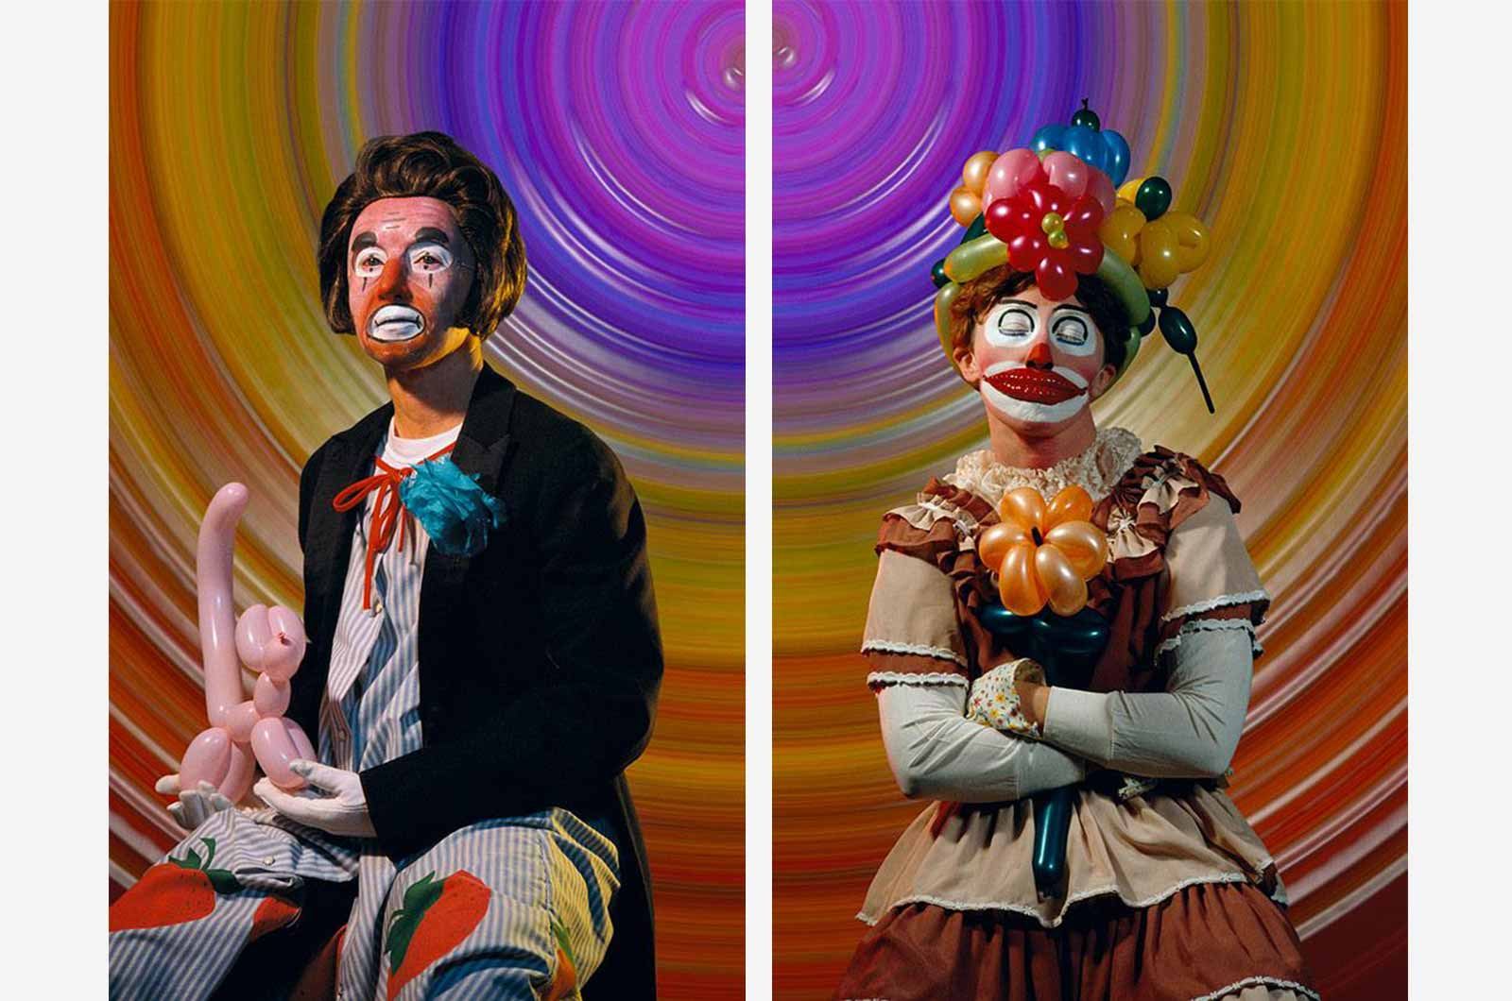
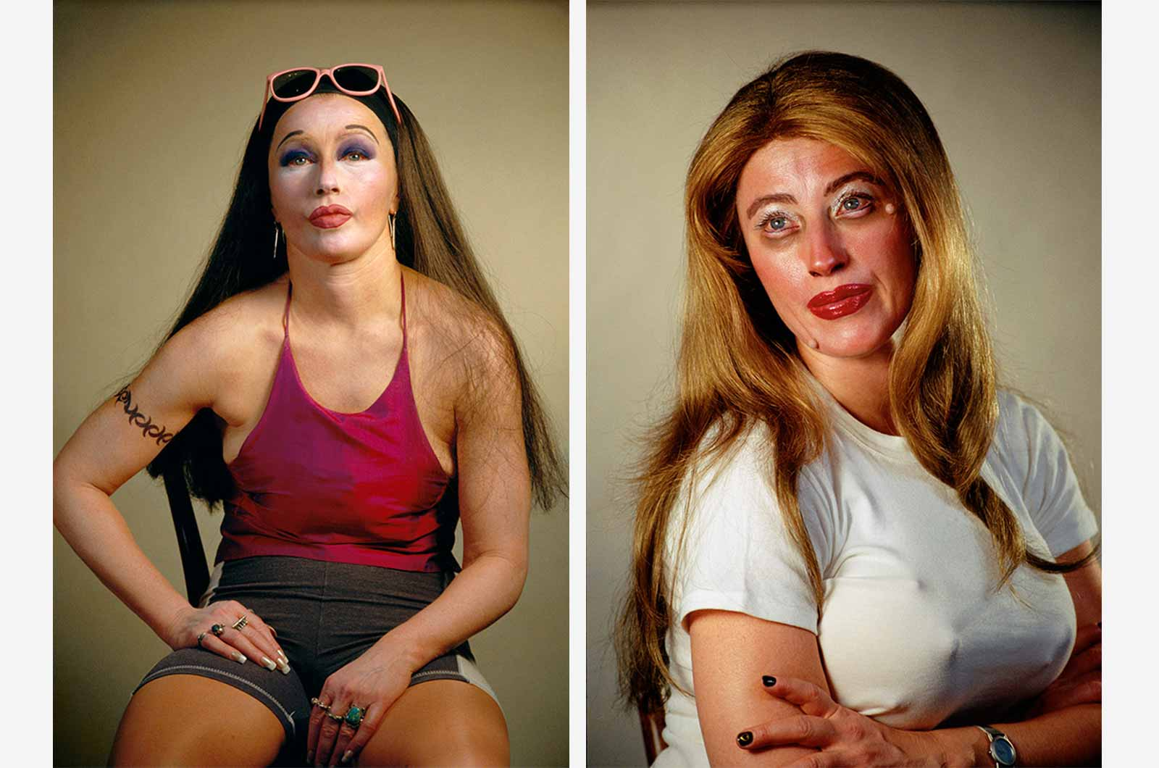
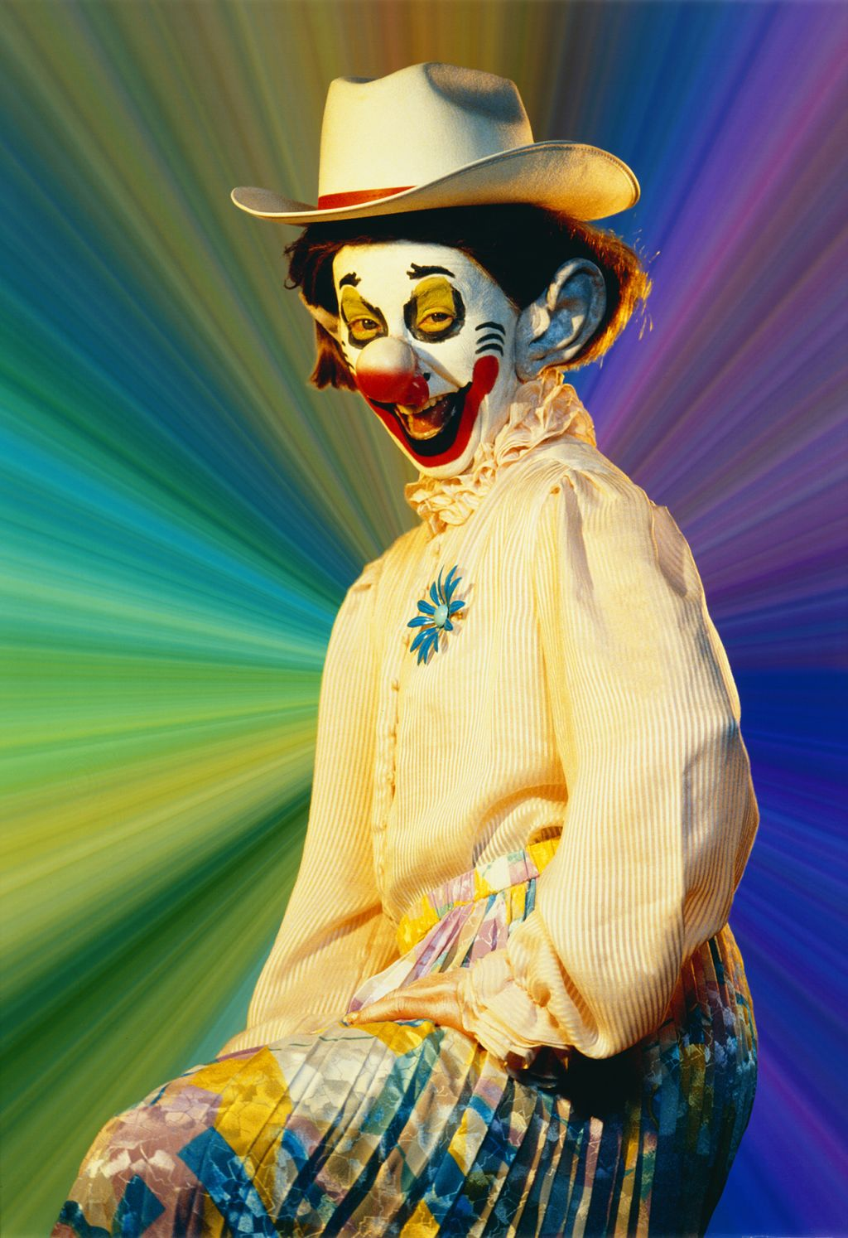
PROPS and costumes

Slide 10
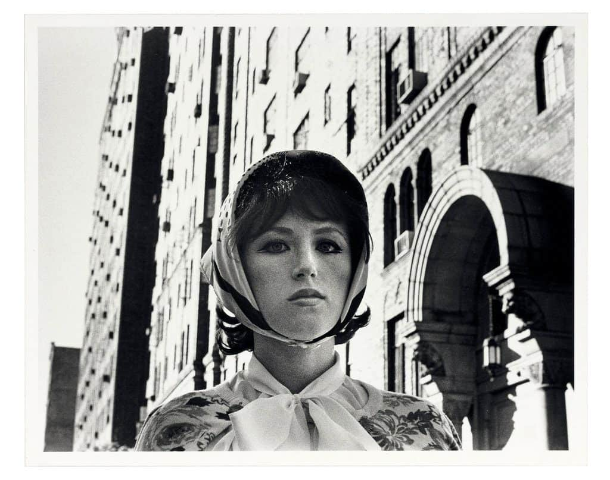
Art Movements
Sherman's Involvement
Cindy Sherman played a significant role in the Pictures Generation, an art movement of the 1970s and 1980s.
This movement challenged traditional ideas about art by using existing images from mass media.
Overview of the Movement
The Pictures Generation focused on exploring how mass media shapes society.
Artists like Sherman used existing images to create new artworks, questioning the power of media in shaping our perceptions.

Slide 11
Controversy and Influence
What Made Cindy Sherman Controversial and Influential
Self-portraiture challenged traditional ideas of identity.
Critiqued gender stereotypes and cultural norms.
Sparked discussions about feminism and representation.
Impact of Self-Portraiture
Explored complexities of identity and representation.
Highlighted fluidity of gender and roles.
Legacy
Inspired artists to challenge conventions.
Continues to shape discussions on identity and representation.

Slide 12
Sources: Information
https://www.moma.org/artists/5392
https://www.macfound.org/fellows/523/
https://www.britannica.com/biography/Cindy-Sherman
https://books.google.com/books?id=64ZfpJhzxx4C&q=%22Her+mother,+Dorothy+Sherman,+taught+remedial+reading+in+the+public+school+system,%22+and+her+father,+Charles+Sherman,+worked+as+an+engineer.%22
https://books.google.com/books?id=64ZfpJhzxx4C&q=%22Her+mother,+Dorothy+Sherman,+taught+remedial+reading+in+the+public+school+system,%22+and+her+father,+Charles+Sherman,+worked+as+an+engineer.%22
https://www.worldcat.org/oclc/24400018
https://www.moma.org/interactives/exhibitions/1997/sherman/

Slide 13
Sources: IMAGES
https://res.cloudinary.com/smimagebank/image/upload/w_1024,c_limit,fl_progressive/v1662547995/sprueth_magers_Cindy_Sherman_Untitled_410_2003_17670.jpg
https://artlead.net/journal/modern-classics-cindy-sherman-untitled-film-stills/
https://awomensthing.org/blog/cindy-sherman/
https://www.moma.org/artists/5392
https://www.forbes.com/sites/natashagural/2020/02/13/cindy-sherman-beguiles-france-with-45-years-of-astonishing-portraits/?sh=62d7c03d1737

Slide 14
Thank you for being with me

